Slide 1
Canal Building Performance
Report
Amirreza Banayan, Arun Balasubramanian, & Tlotliso Monyau

Slide 2
Agenda
Inverse Modelling
Load Disaggregation
Fault Detection and Diagnostics
Final tips & takeaways

Slide 3
Inverse Modeling

Slide 4
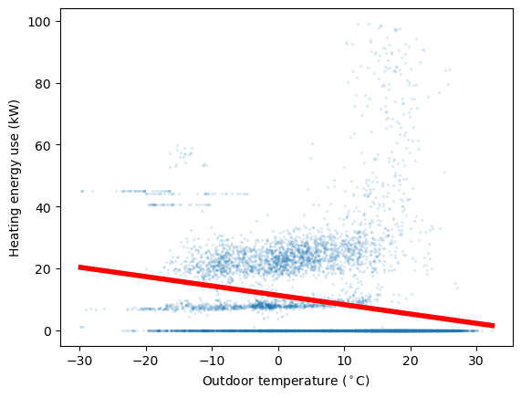
Change point model: Heating
IM

Slide 5
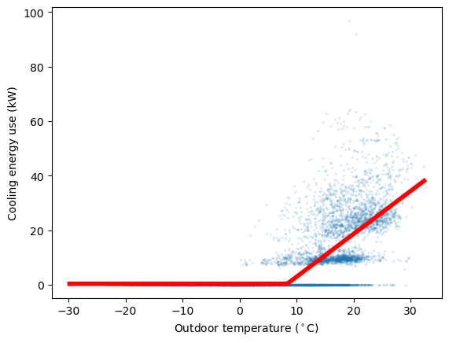
IM
Change point model: Cooling

Slide 6
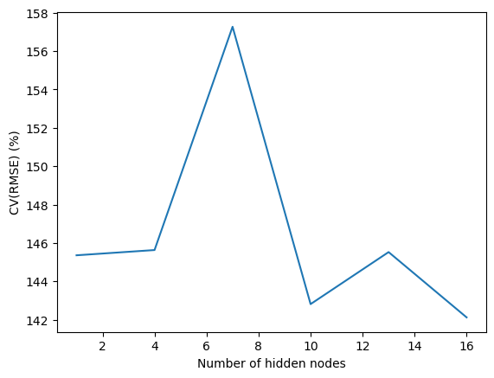
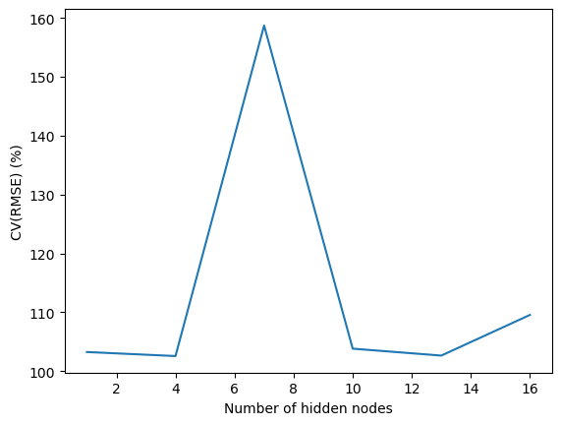
IM
Neural network
Heating
Cooling

Slide 7
Load Disaggregation

Slide 8
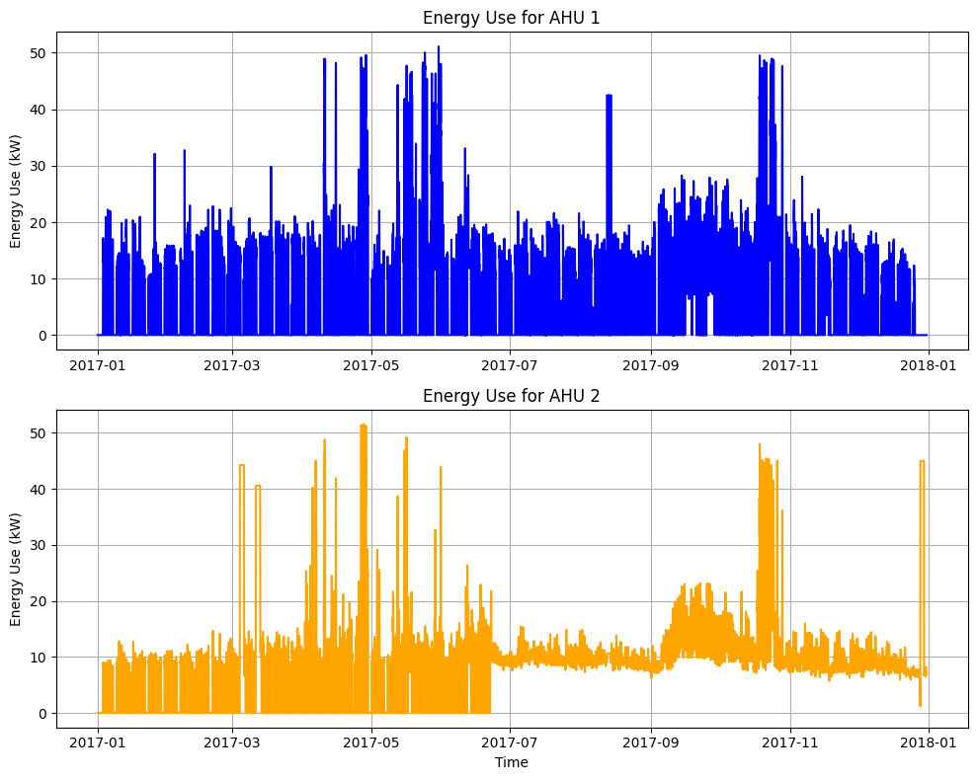
Air Handling Units
LD
Peak energy use occurs in June
Peak energy use occurs in April
Abnormal Isolated Spikes
March, December

Slide 9
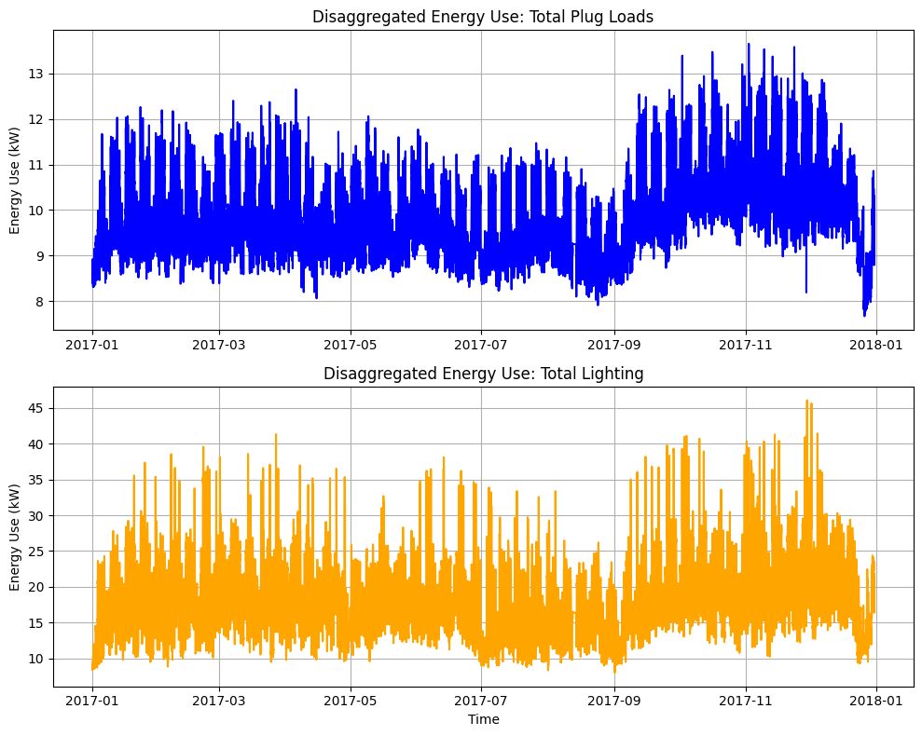
Plug Loads and Lighting
LD

Slide 10
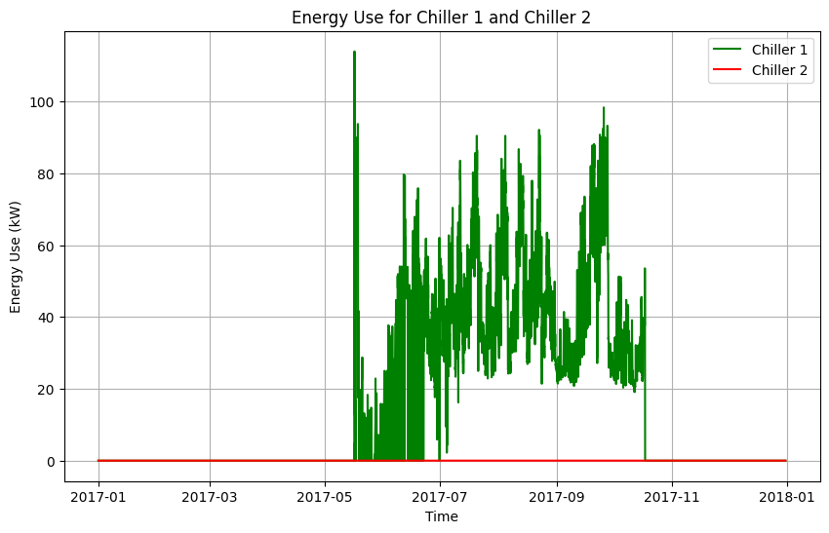
Chillers
LD
Energy Spike in May

Slide 11
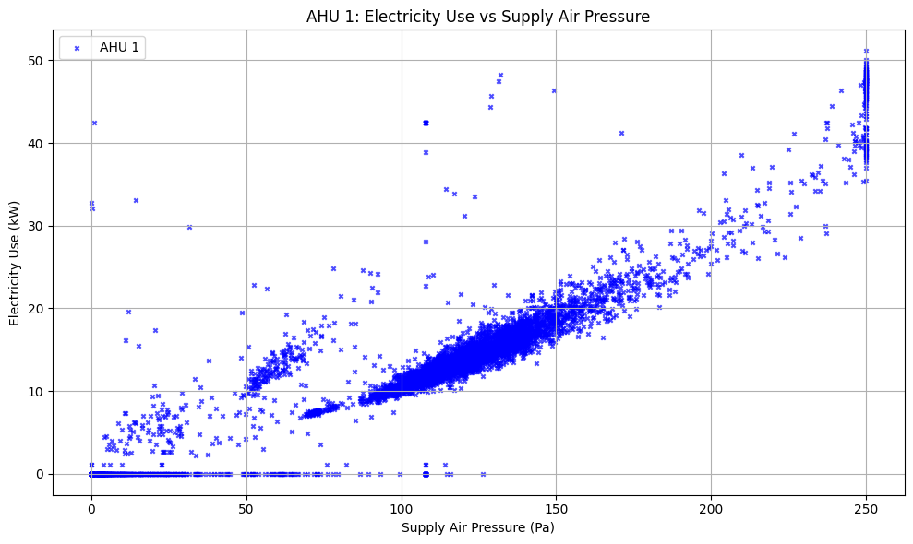
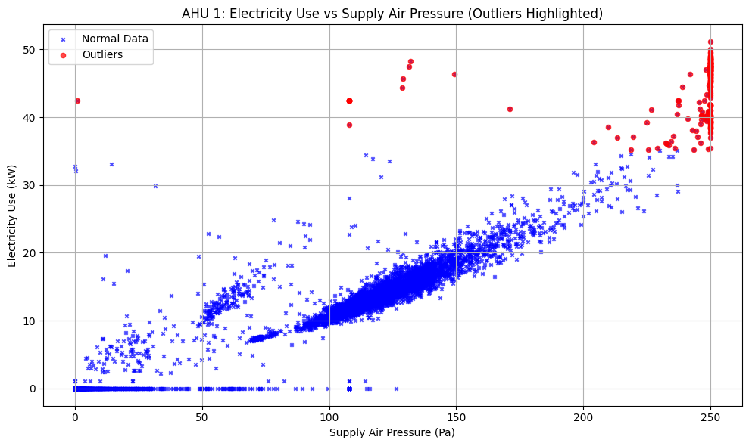
Electricity Use vs Demand
LD
(Outliers)
Upper Bound
Q3 + 1.5 * IQR
Lower Bound
Q1 – 1.5 * IQR

Slide 12
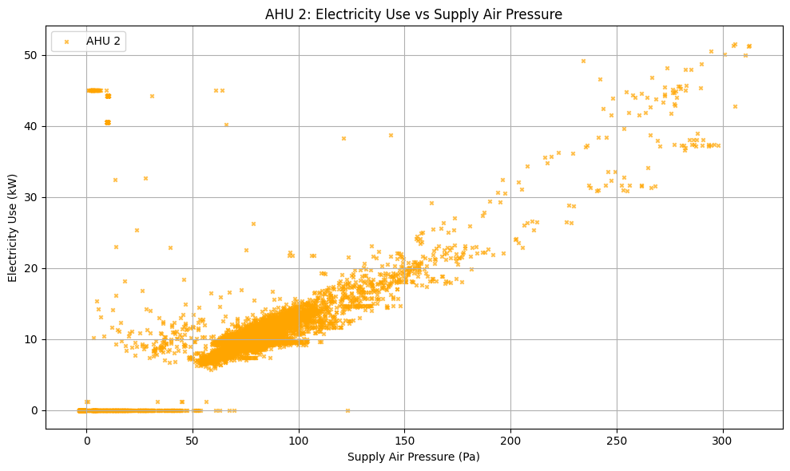
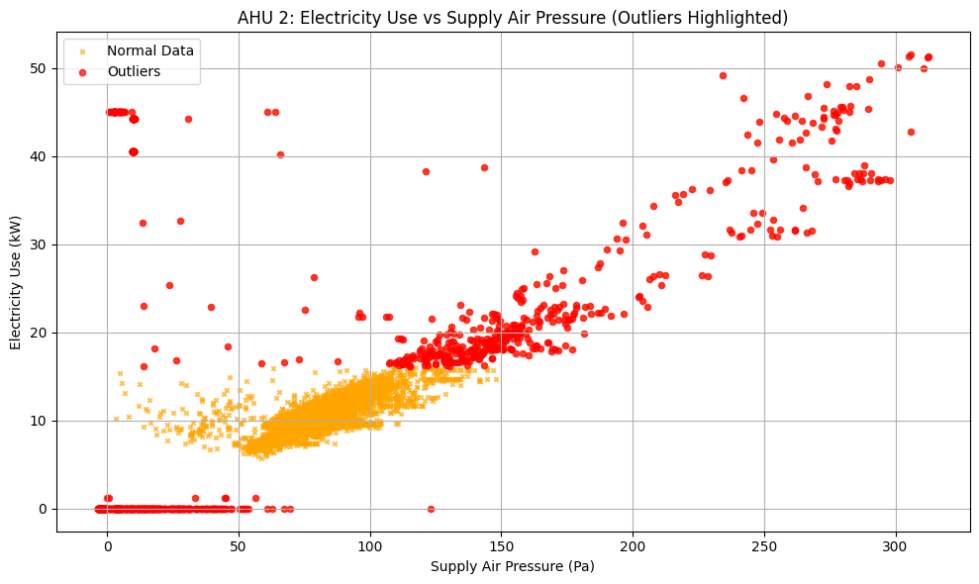
Electricity Use vs Demand
LD
(Outliers)
Upper Bound
Q3 + 1.5 * IQR
Lower Bound
Q1 – 1.5 * IQR

Slide 13
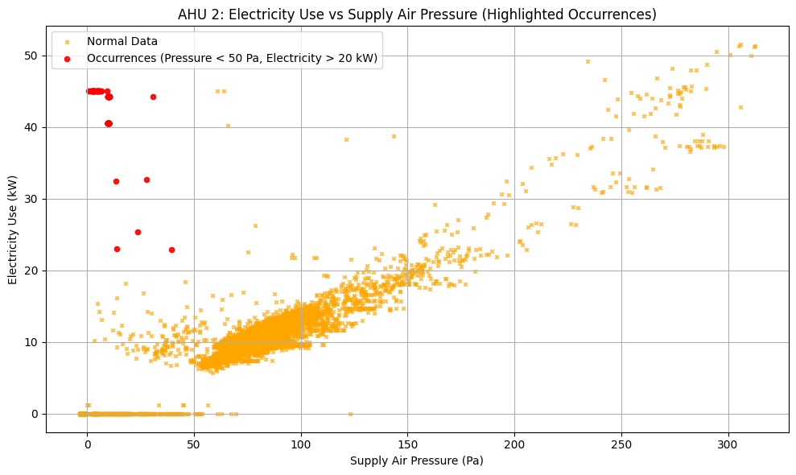
Focused Analysis
LD

Slide 14
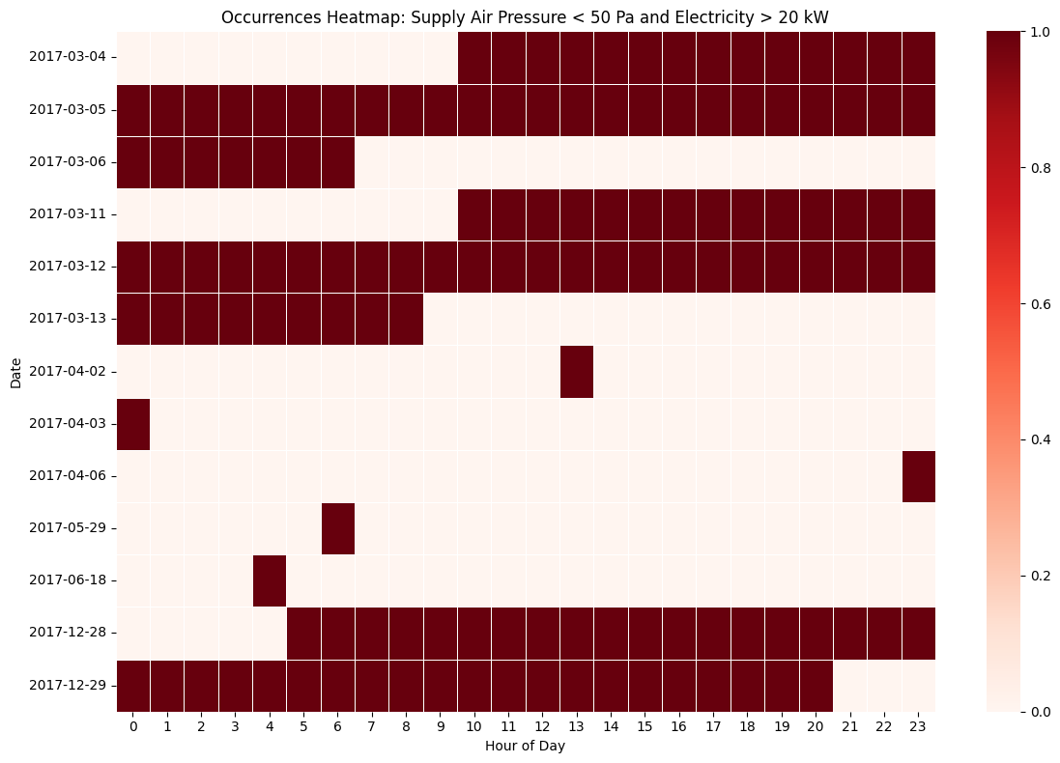
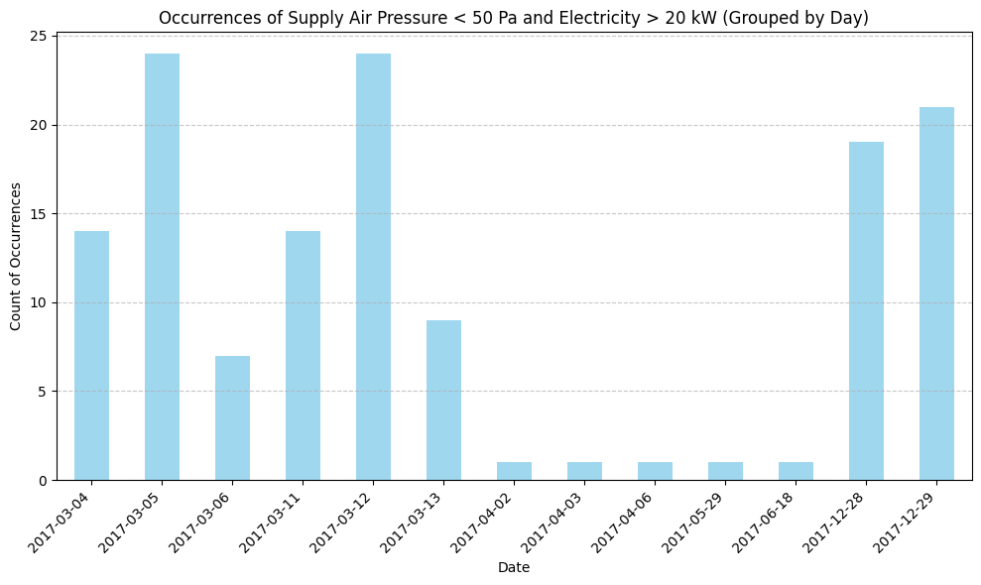
Focused Analysis
LD

Slide 15
Fault Detection and Diagnostics

Slide 16
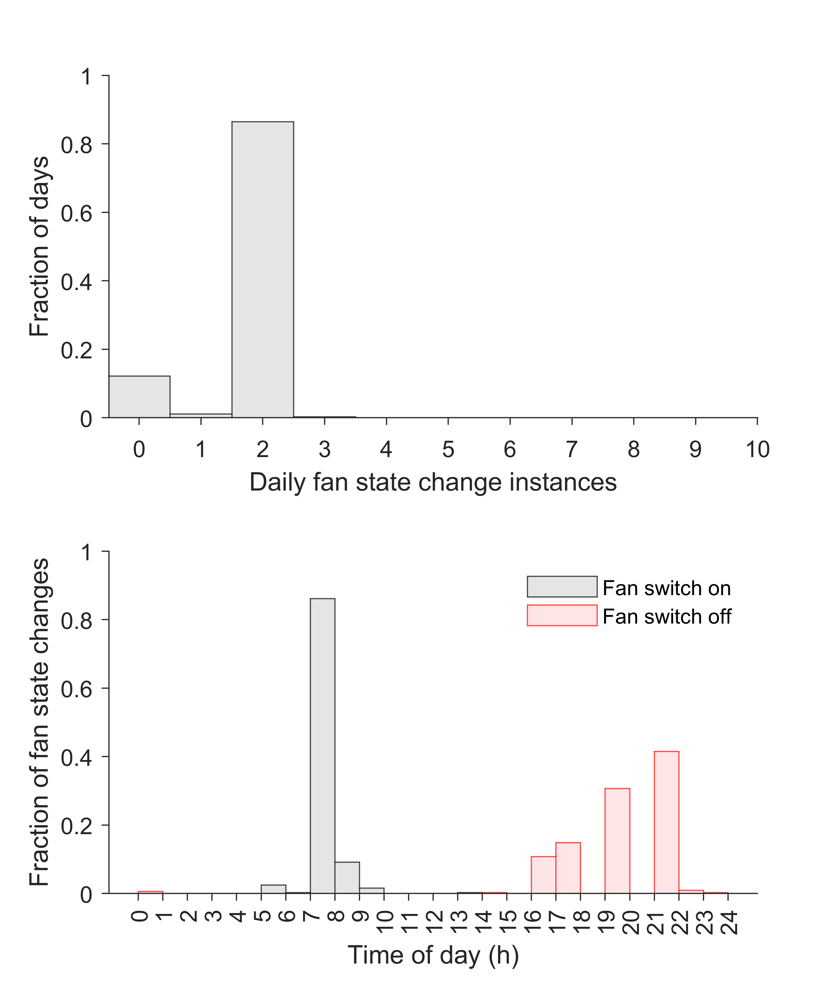
Soft Faults – Mode of Operation
FDD
AHU 1
AHU 2

Slide 17
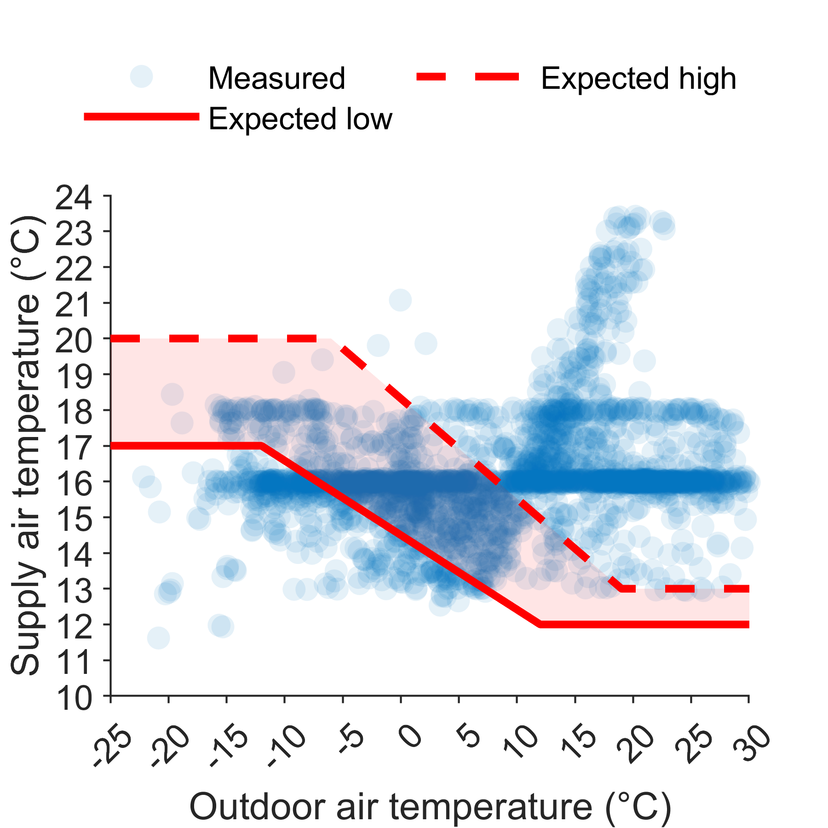
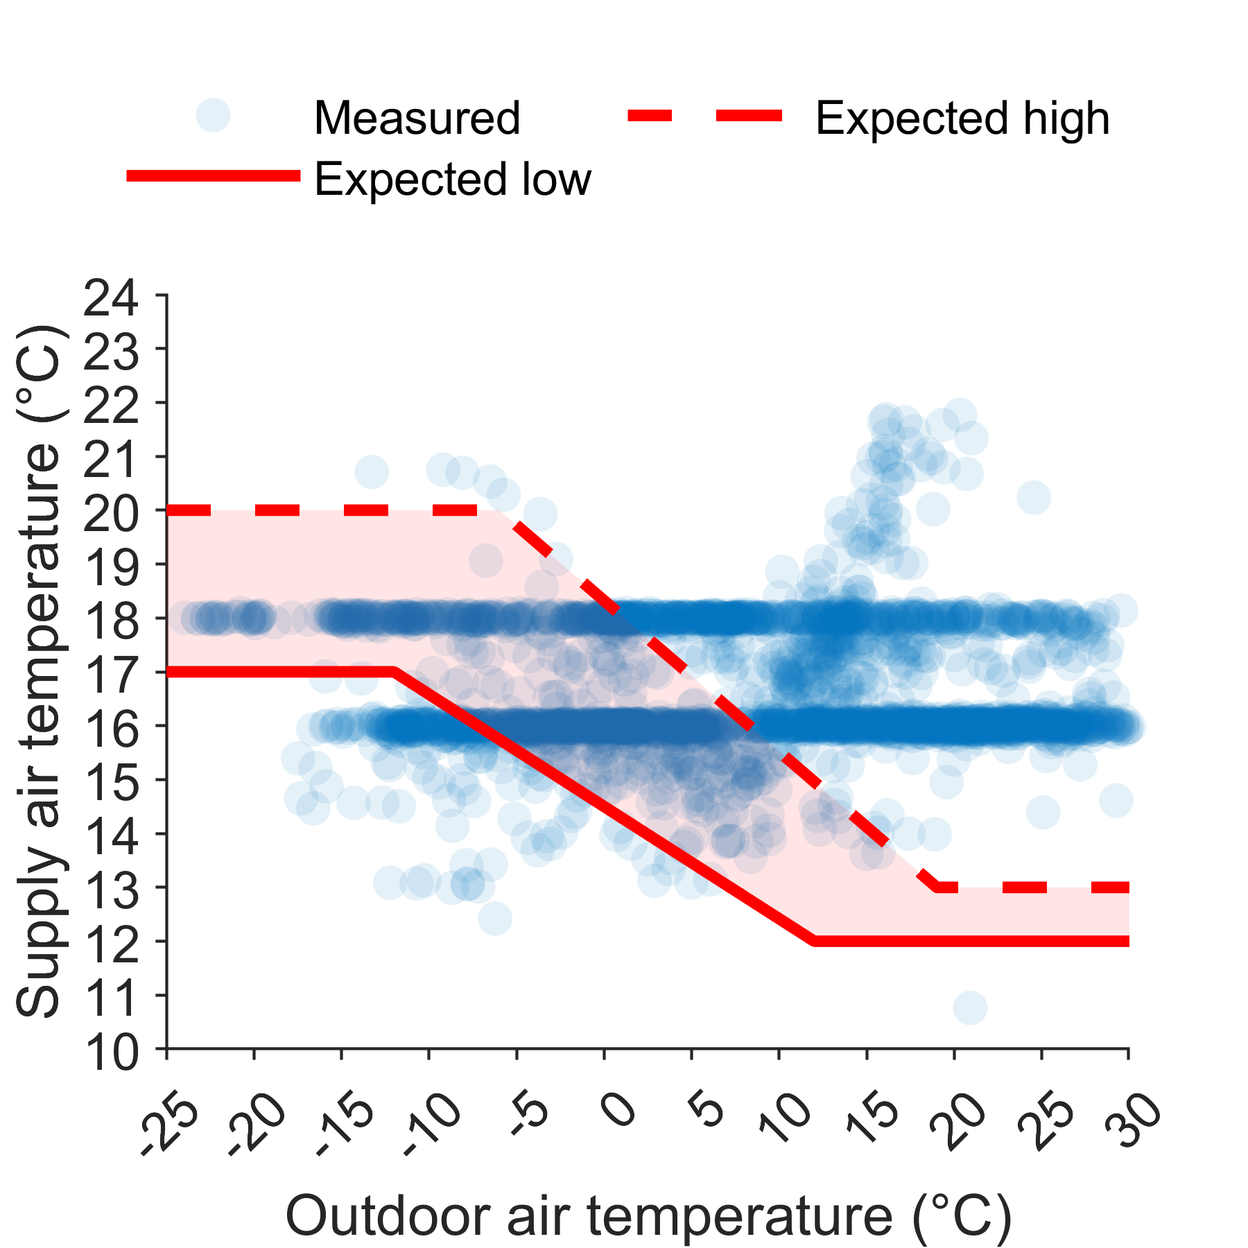
Soft Faults – Supply Air Temperature
FDD
AHU 1
AHU 2

Slide 18
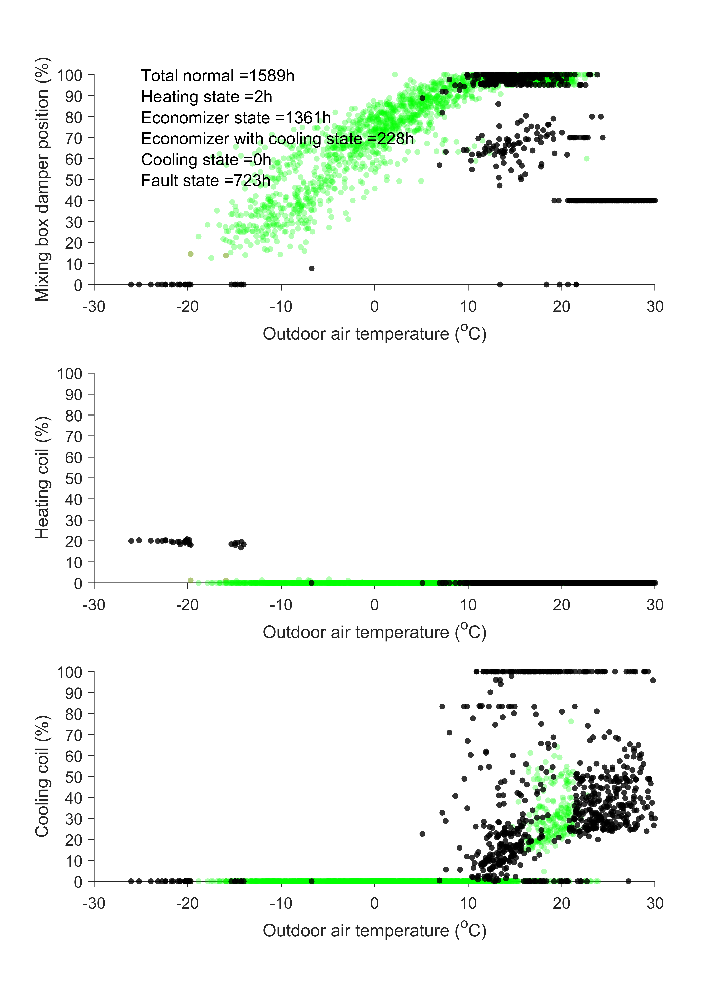
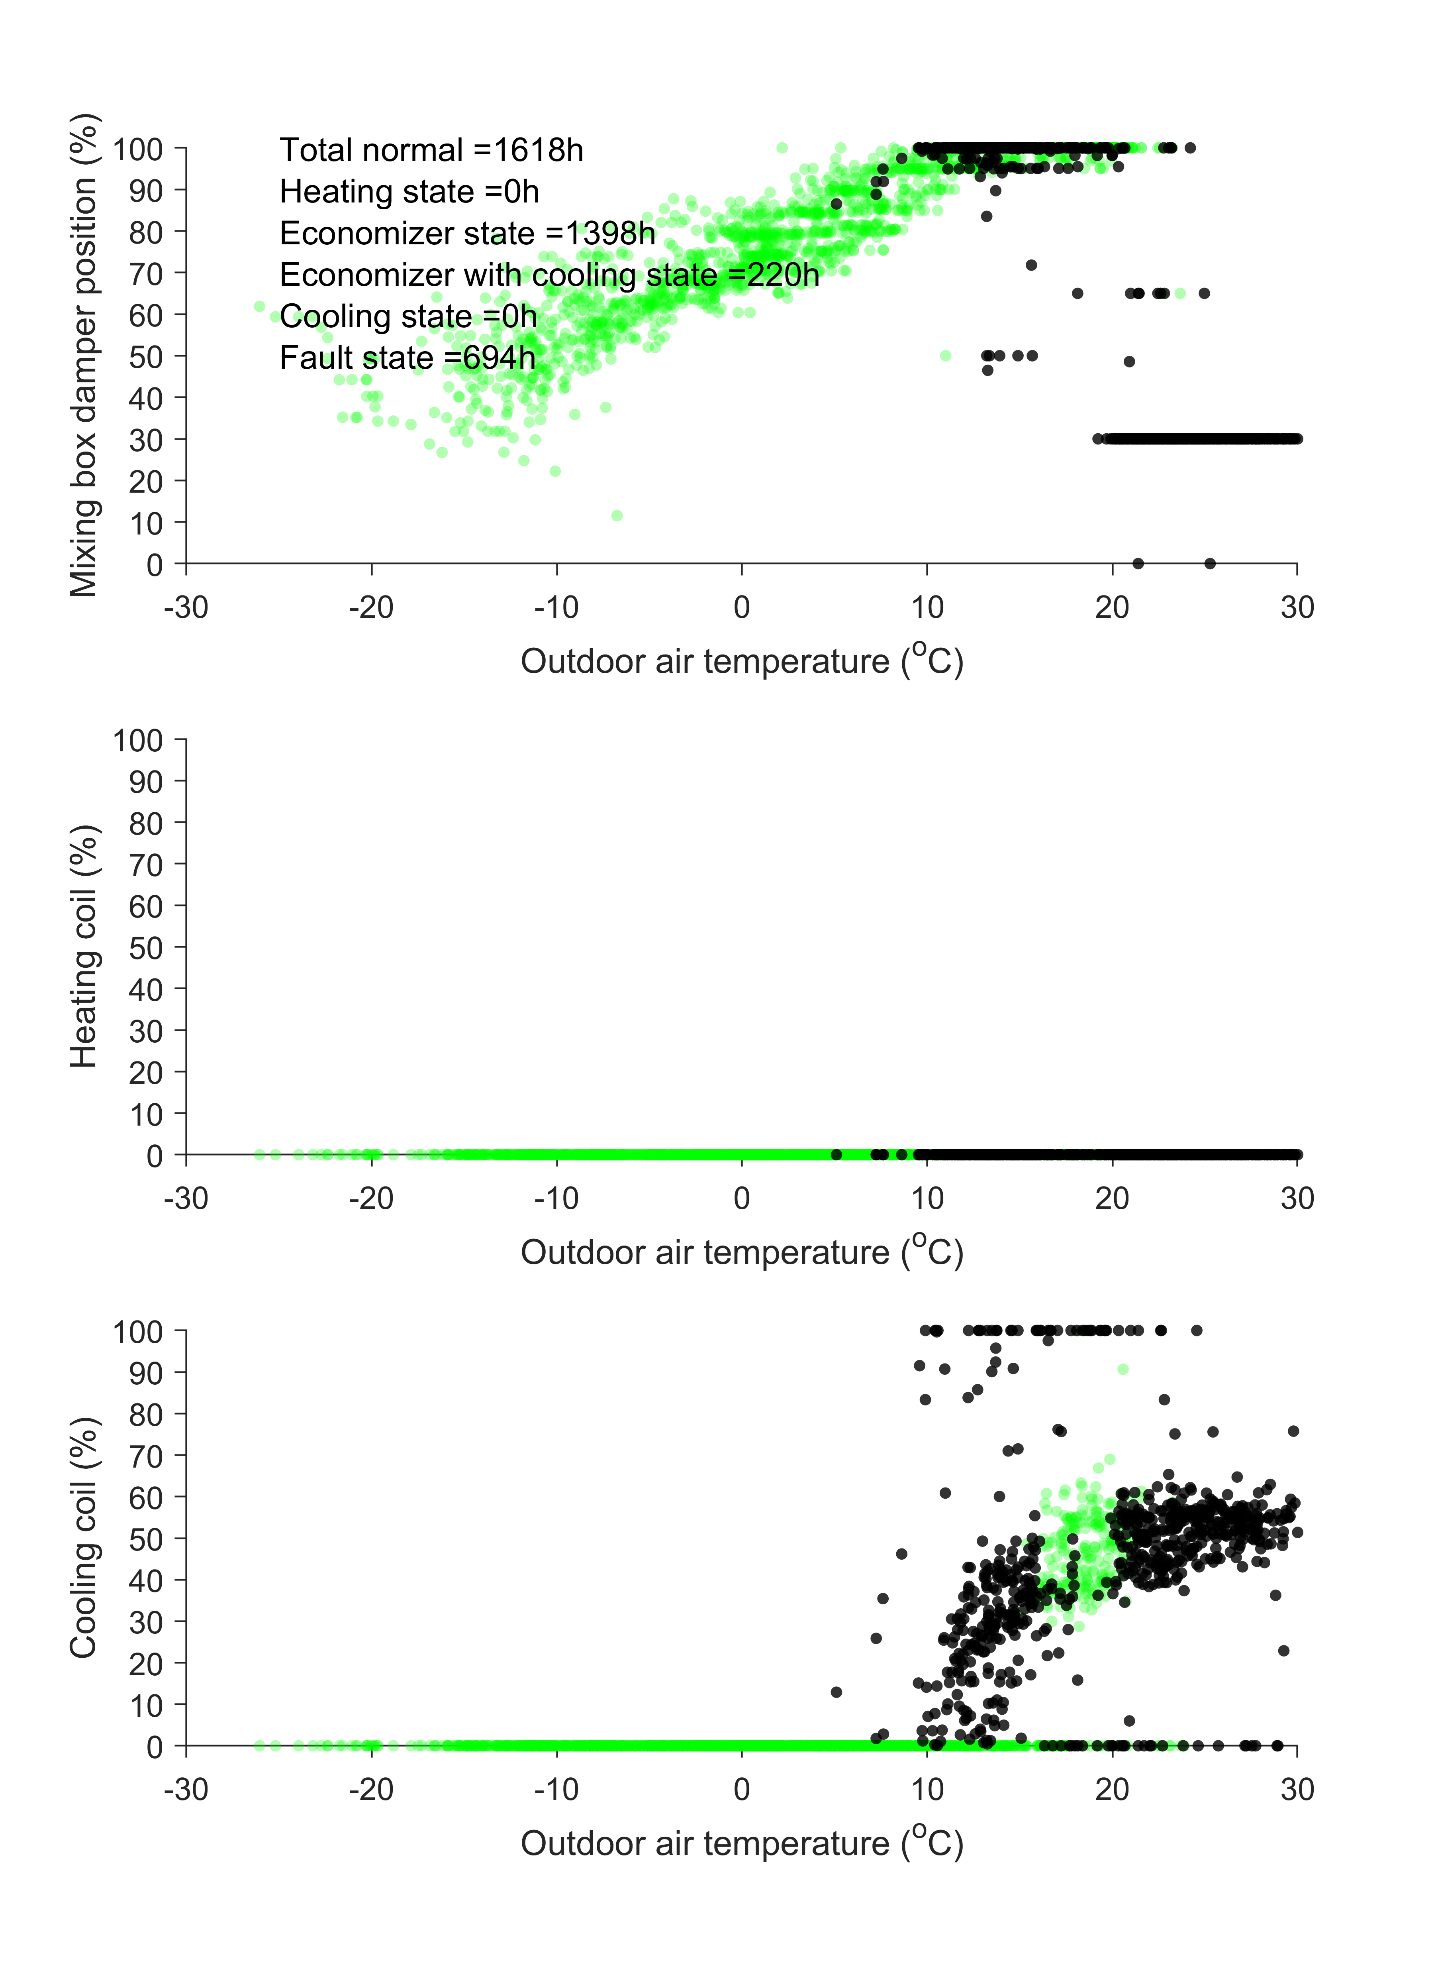
Soft Faults – State of Operation
FDD
AHU 1
AHU 2

Slide 19
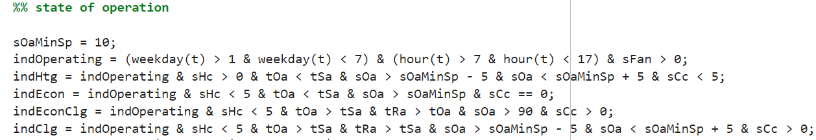
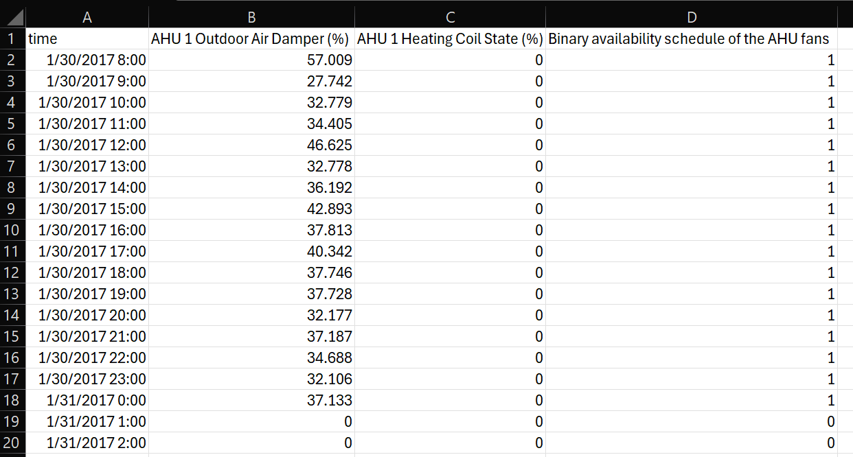
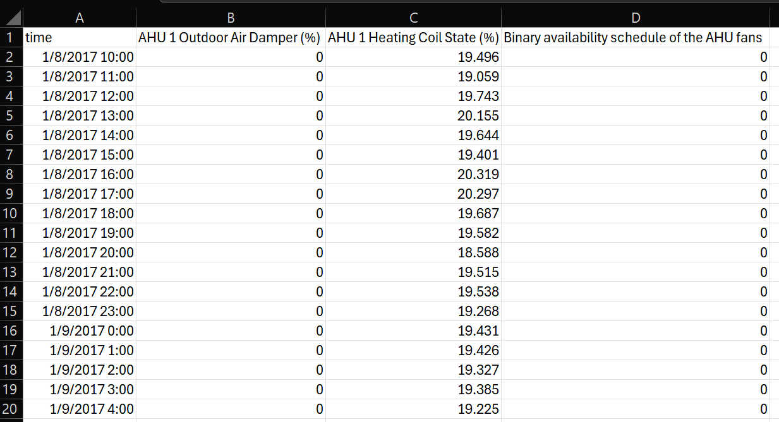





Soft Faults
FDD

Slide 20
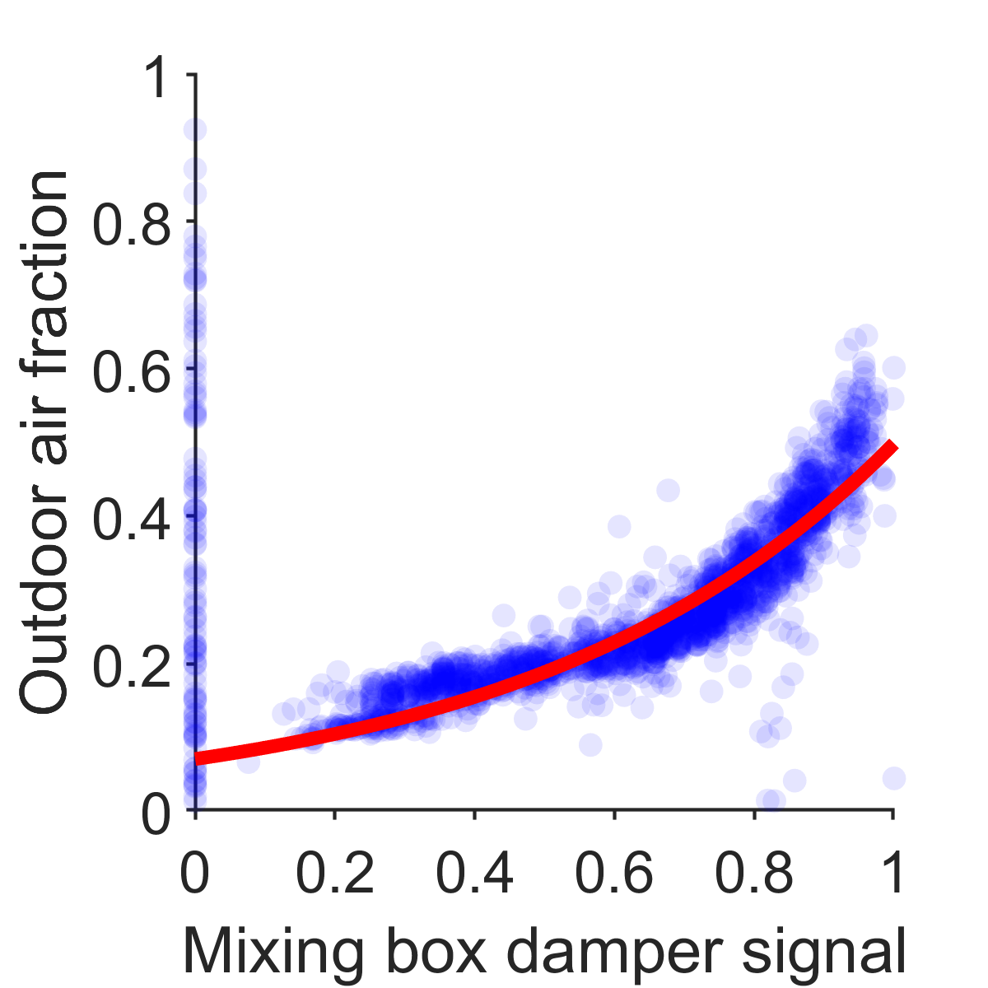
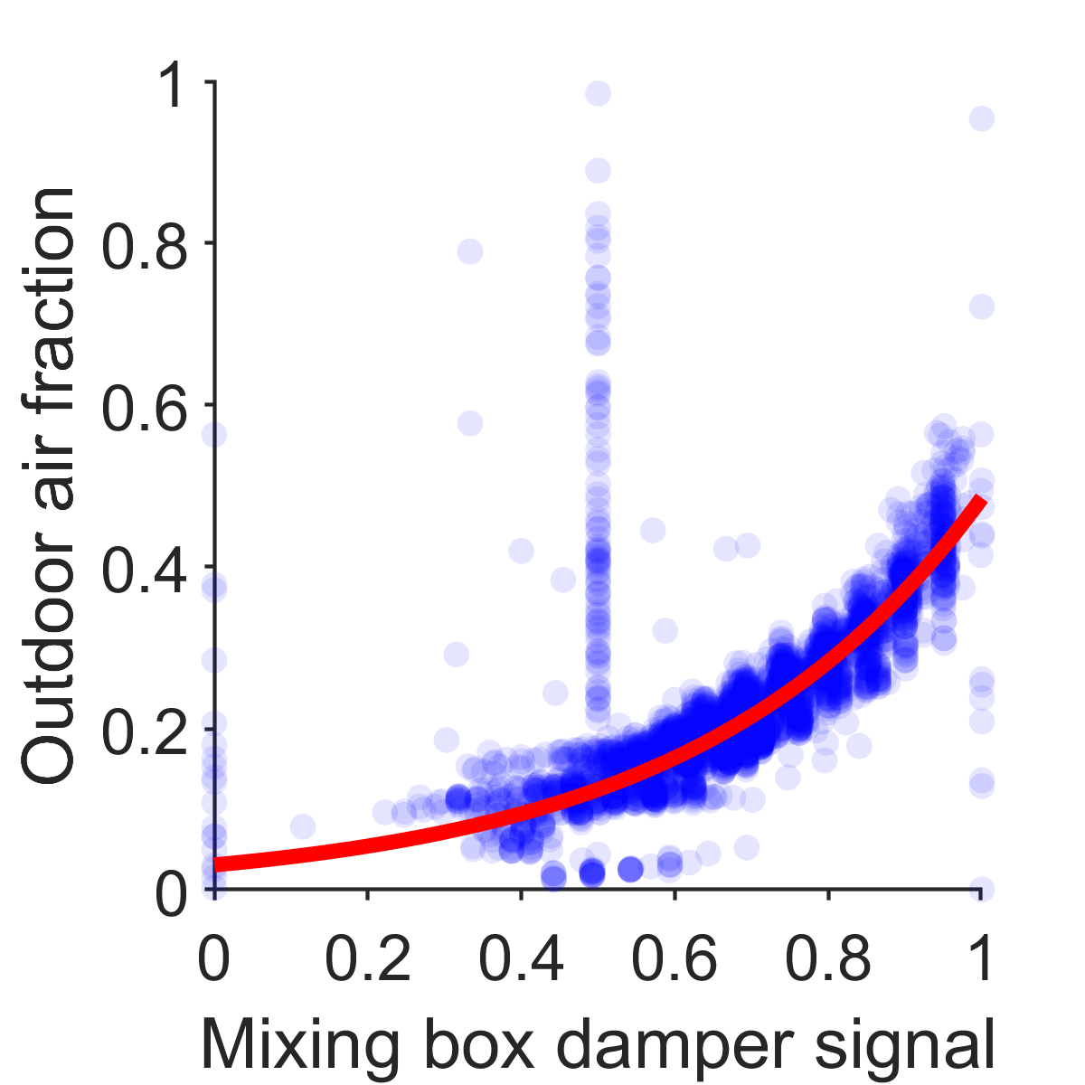
Hard Faults
FDD
AHU 1
AHU 2

Slide 21
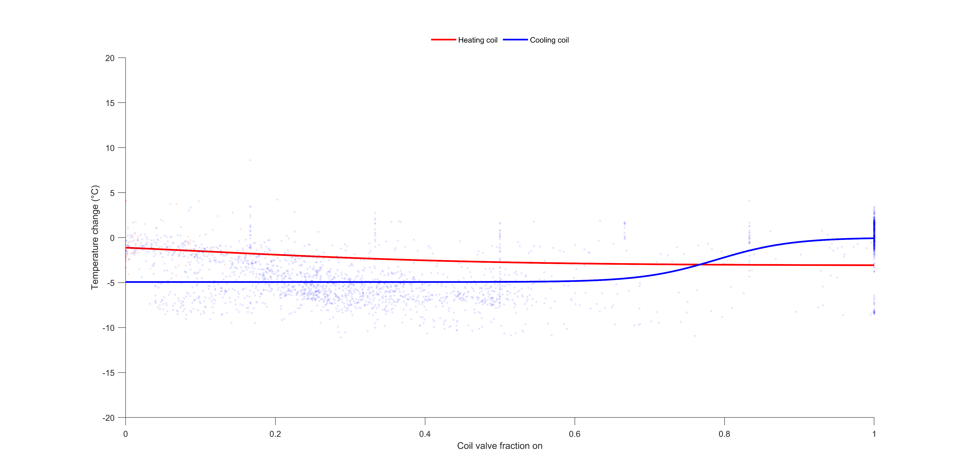
Hard Faults
FDD
AHU 1

Slide 22
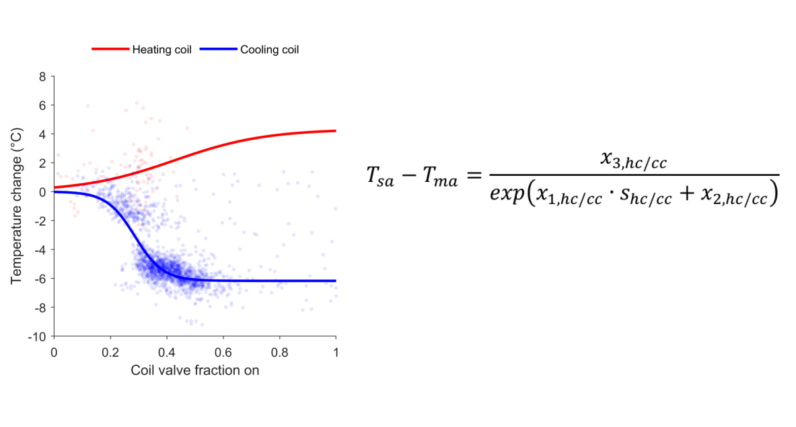
Hard Faults
FDD
Expected behaviour

Slide 23
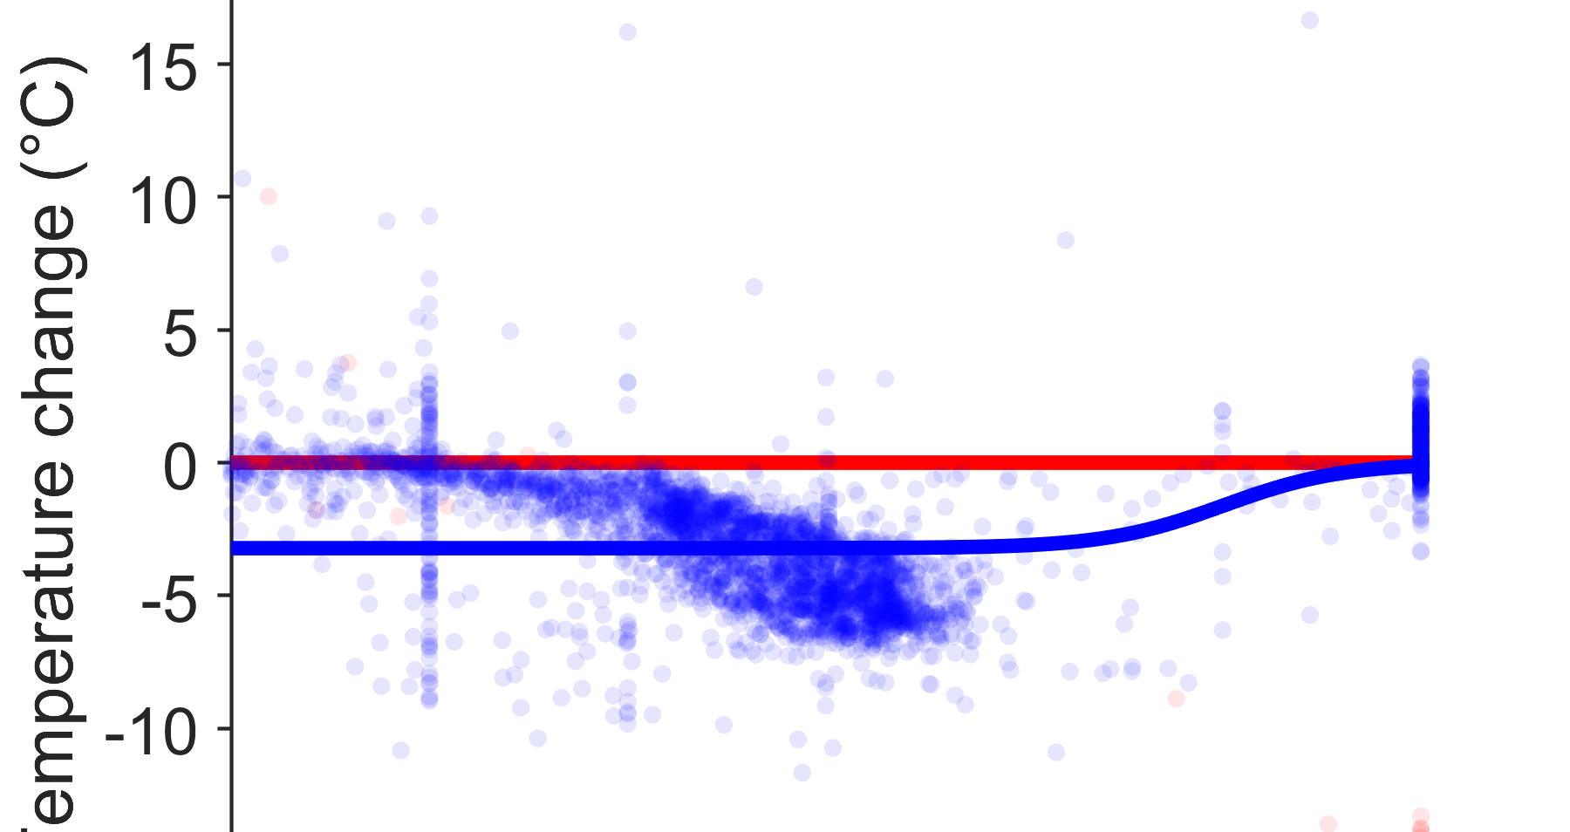
Hard Faults
FDD
AHU 2

Slide 24
Thank you

